Slide 1
Multi-Process TCP Server
School of Information and Communication Technology,
Hanoi University of Science and Technology

Slide 2
References
[1] W.Richard Stevens, Unix Network Programming Vol.1, 3rd Ed., Prentice Hall.
[2] Keir Davis, John W. Turner, and Nathan Yocom, The Definitive Guide to Linux Network Programming, Apress.
[3] Michael Donahoo, Kenneth Calvert, TCP/IP Sockets in C: Practical Guide for Programmers, Elsevier.

Slide 3
Content
Forking Server
Signaling
Signal Handling

Slide 4
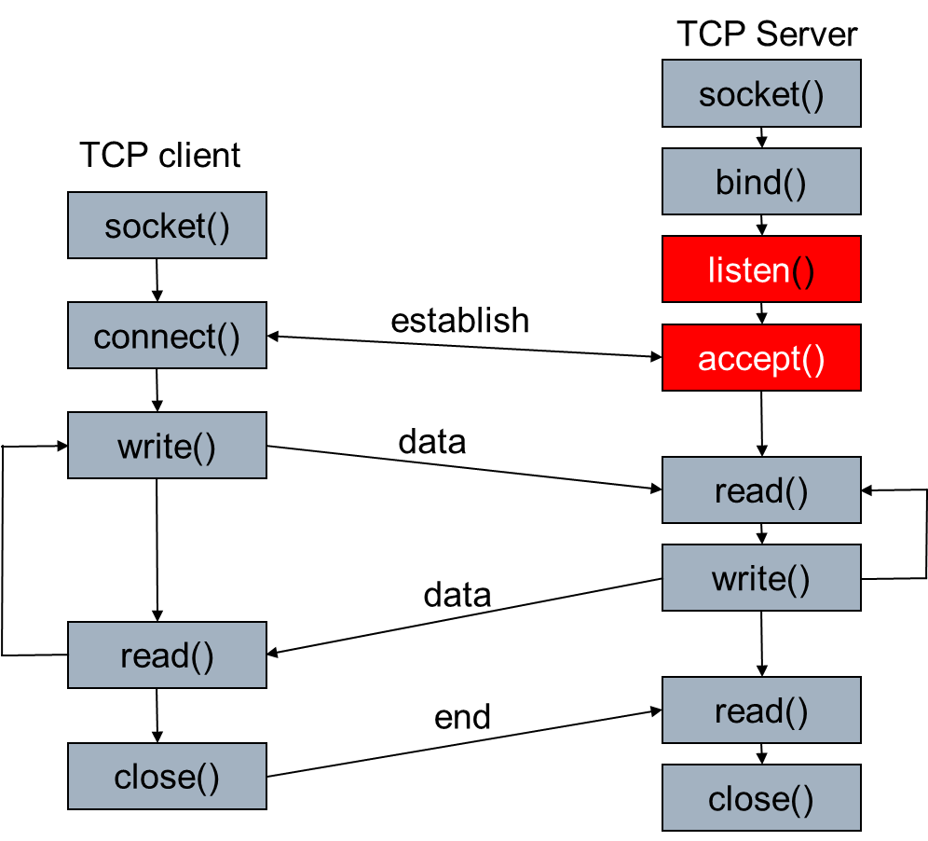
Single-client Server

Slide 5
Fork process
fork is an operation where a process creates a copy of itself
Happen in multitask operating system when a process launch another process → child process
The parent process makes a copy of its memory and gives to the child process
Fork system call is first introduced in UNIX.
First process in Linux is “init”
#include <unistd.h>
pid_t fork(void);

Slide 6
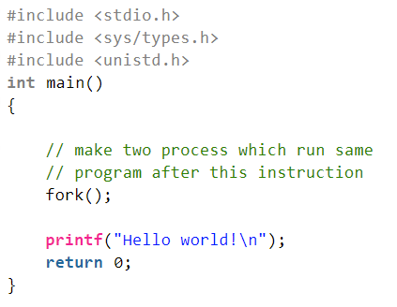
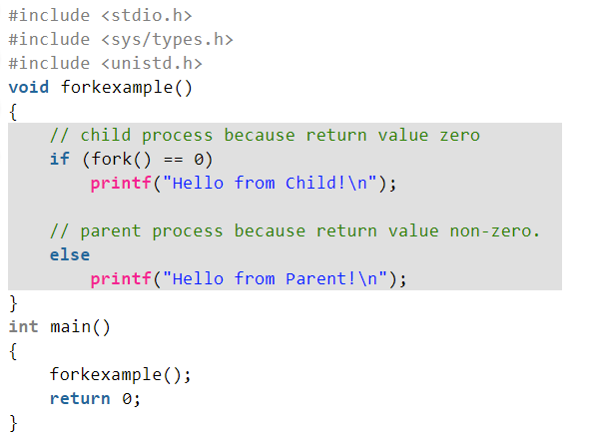
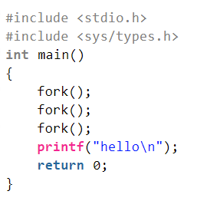
fork examples

Slide 7
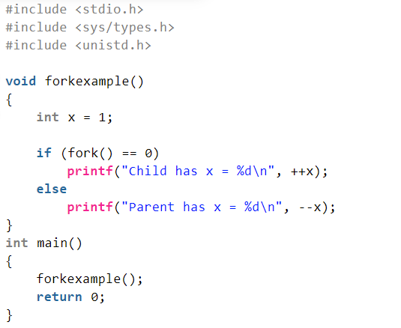
fork examples

Slide 8
fork
pid_t pid;
int listenfd, connfd;
listenfd = socket( ... );
/* fill in sockaddr_in{} with server's well-known port */
bind(listenfd, ... );
listen(listenfd, 5);
for ( ; ; ) {
connfd = accept (listenfd, ... ); /* probably blocks */
if((pid = fork()) == 0) {
close(listenfd); /* child closes listening socket */
doit(connfd); /* process the request */
close(connfd); /* done with this client */
exit(0); /* child terminates */
}
close(connfd); /* parent closes connected socket */
}

Slide 9
Child Process Termination
We use forking server, when a child process ends, it sends the SIGCHLD signal to the parent
Information about the child process is still maintained in “process table” in order to allow its parent to read the child exit status afterward.
If SIGCHLD is ignored
Child process will not running but still consumes system resources (in process table)
→ it is in zombie state
We need to handle SIGCHLD signal
Make the child process to wait until the parent read its exit status
once the exit status is read via “wait” system call, the zombie's entry is removed from the process table

Slide 10
Signaling
A signal is a notification to a process that an event has occurred.
Signals are sometimes called software interrupts.
Signals usually occur asynchronously.
A process doesn't know ahead when a signal will occur.
Signals can be sent
By one process to another process (or to itself)
By the kernel to a process

Slide 11
Signaling
Typing certain key combinations at the controlling terminal of a running process causes the system to send it certain signals:
Ctrl-C sends an INT signal ("interrupt", SIGINT)
Ctrl-Z sends a TSTP signal ("terminal stop", SIGTSTP)
Ctrl-\ sends a QUIT signal (SIGQUIT)
by default, this causes the process to terminate and dump core.
SIGHUP is sent to a process when its controlling terminal is closed (a hangup).
SIGTERM is sent to a process to request its termination.
Unlike the SIGKILL signal, it can be caught and interpreted or ignored by the process.

Slide 12
Handle a signal using sigaction
We set/change the disposition of a signal by calling the sigaction function
int sigaction(int signum, const struct sigaction *act, struct sigaction *oldact);
struct sigaction {
void (*sa_handler)(int);
void (*sa_sigaction)(int, siginfo_t *, void *);
sigset_t sa_mask;
int sa_flags;
void (*sa_restorer)(void);
};

Slide 13
Handle a signal using sigaction
Three choices for the disposition:
We can provide in sigaction a function that is called whenever a specific signal occurs (sa_handler)
Prototype: void handler (int signo);
We can ignore a signal by setting sa_handler to SIG_IGN
We can set the default disposition for a signal by setting sa_handler to SIG_DFL.

Slide 14
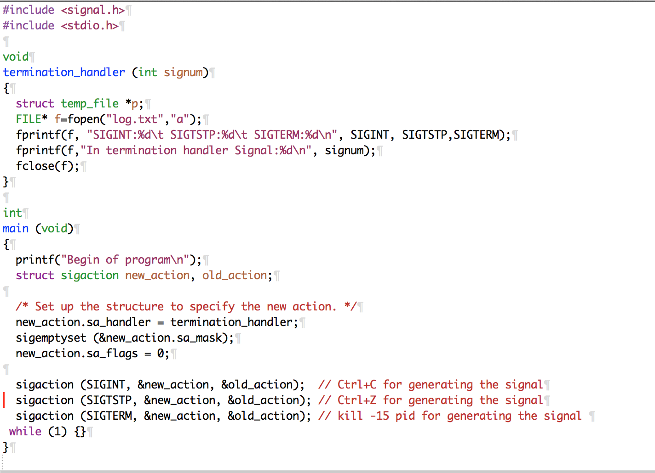
Example

Slide 15
Handle a signal using signal function
An alternative to use sigaction.
<signal.h>
void (*signal(int sig, void (*func)(int)))(int)
Sig: signal to be handled
func: a pointer to a function that handle the signal
Meaning: registration of a function for handling a signal.

Slide 16
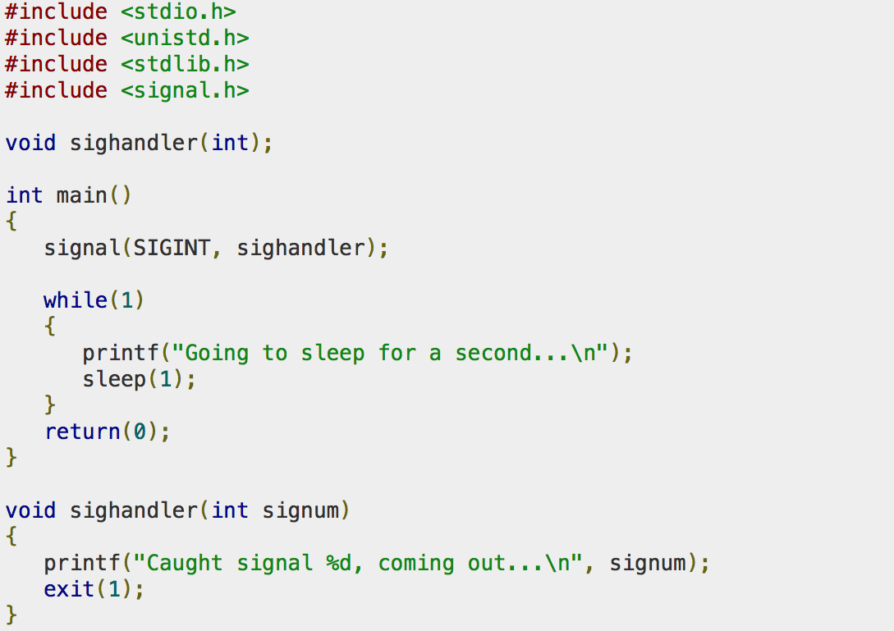
Example

Slide 17
Handling SIGCHLD Signals
The purpose of the zombie state is to maintain information about the child in “process table” for the parent to fetch at some later time.
This information includes the process ID of the child, its termination status, and information on the resource utilization of the child (CPU time, memory, etc.).
They take up space in the kernel and eventually we can run out of processes
Whenever we fork children, parent must wait (read exit status) for them to prevent them from becoming zombies
establish a signal handler to catch SIGCHLD, and within the handler, we call wait
Add into server: signal (SIGCHLD, handler);

Slide 18
wait() and waitpid()
#include <sys/wait.h>
pid_t wait (int *statloc);
pid_t waitpid (pid_t pid, int *statloc, int options);
Wait for the status change of a process. Status changes are:
the child terminated;
the child was stopped by a signal; or
the child was resumed by a signal.
Use to handle the terminated child
Both return two values:
The return value of the function
is the process ID of the terminated child if OK
0 or -1 if error
The termination status of the child (an integer) is returned through the statloc pointer.

Slide 19
wait()
wait for state changes in a child of the calling process
In the case of a terminated child, performing a wait allows the system to release the resources associated with the child;
if a wait is not performed, then the terminated child remains in a "zombie" state

Slide 20
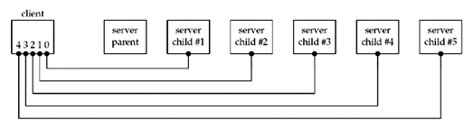
wait() vs waitpid()
Create 5 connections from a client to a forking server
When the client terminates, all open descriptors are closed automatically by the kernel
→ five connections ended simultaneous

Slide 21
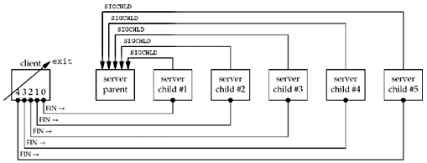
wait() vs waitpid()
→ five SIGCHILD is sent
The signal is handled once with wait () in the server
→ four children are zombies
It can happen when many users connect to a server
→ we have to use waitpid()

Slide 22
waitpid()
pid_t waitpid (pid_t pid, int *statloc, int options);
pid < 0: wait for status change of any child process whose process group ID is equal to the absolute value of pid.
pid = -1: wait for for status change of any child process.
pid = 0: wait for any child process whose process group ID is equal to that of the calling process
pid > 0: wait for the child whose process ID is equal to the value of pid
Without option WNOHANG, waitpid blocks until the status change
With option WNOHANG, waitpid returns immediately
Return
Pid of the child whose state has changed
With option WNOHANG, return 0 if the specified process has not changed status.

Slide 23
Forking server
pid_t pid;
int listenfd, connfd;
signal(SIGCHLD,sig_chld);
listenfd = socket( ... );
bind(listenfd, ... );
listen(listenfd, 5);
for ( ; ; ) {
connfd = accept (listenfd, ... ); /* probably blocks */
if( (pid = fork()) == 0) {
close(listenfd); /* child closes listening socket */
doit(connfd); /* process the request */
close(connfd); /* done with this client */
exit(0); /* child terminates */
}else
close(connfd); /* parent closes connected socket */
}

Slide 24
sig_chld: SIGCHLD handler
void sig_chld(int signo)
{
pid_t pid;
int stat;
while ( (pid = waitpid(-1, &stat, WNOHANG)) > 0)
printf("child %d terminated\n", pid);
return;
}
/*
WNOHANG: waitpid does not block
while loop: waitpid repeatedly until there is no child process change status, i.e until waitpid returns 0.
*/

Slide 25
Exercise
1) Make your TCP EchoServer be able to work with multiple client in the same time
Use forking process
Handle the SIGCHLD signal in server
2) Write a “chat room” forking server
Accept connection from multiple clients
Receive a message from one client then forward to all the others.

Slide 26
File Sharing
Viết một chương trình server và 1 client
Server:
Fork để tạo 1 tiến trình con chuyên recvfrom từ các client broadcast <TÊN> và lưu thông tin <IP> <TÊN> vào 1 file dùng chung.
Fork để tạo 1 tiến trình con chuyên đợi TCP 5000 và accept: Mỗi lần accept tạo một kết nối và trả về danh sách các <IP> và <TÊN> cho client rồi đóng luôn kết nối.

Slide 27
Q&A

